Slide 1

UNIT 1; Friends
Friends

Slide 2
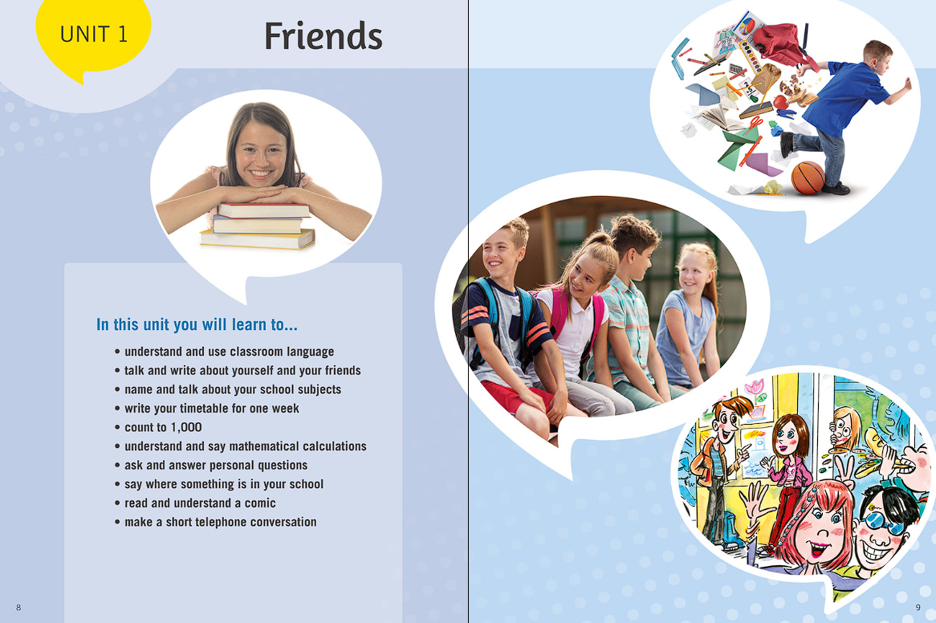

Slide 3
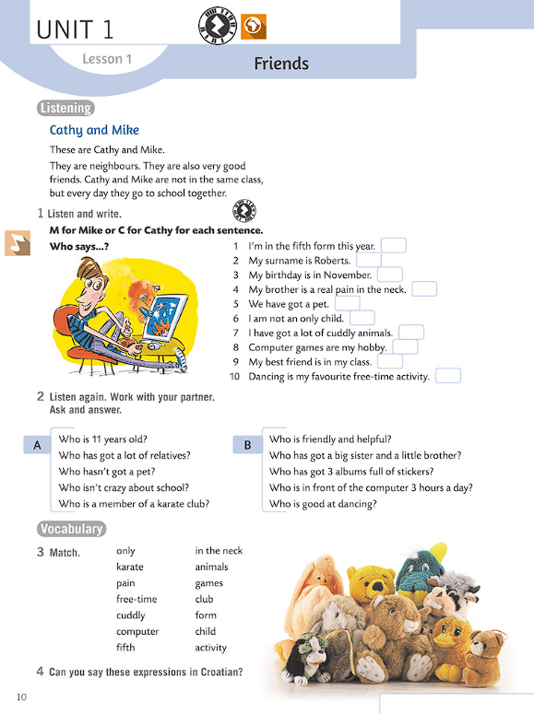


Who are these?
How old are they?
Where do they live?
Have they got any hobbies?
What do they like doing?

Slide 4
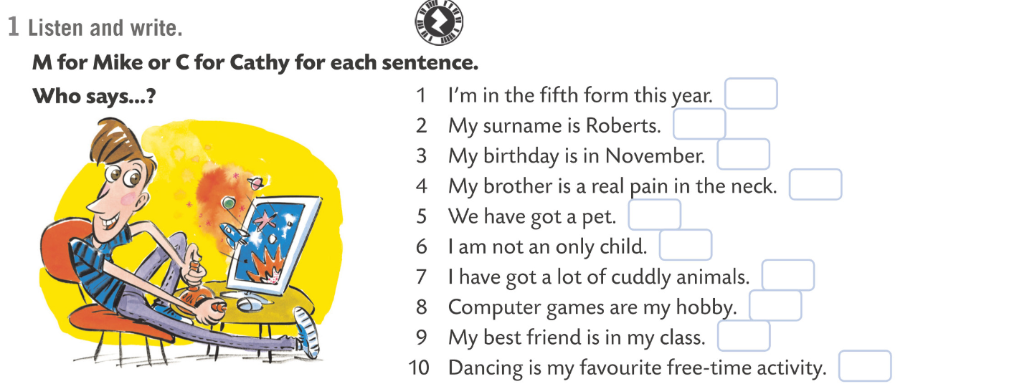
1 Idem u 5. razred ove godine.
2 Moje prezime je Roberts.
3 Moj rođendan je u studenome.
4 Moj brat je pravi dosadnjaković.
5 Imamo kućnog ljubimca.
6 Nisam jedino dijete.
7 Imam mnogo plišanih životinja.
8 Računalne igrice su moj hobi.
9 Moj najbolji prijatelj ide sa mnom u razred.
10 Plesanje je moja omiljena aktivnost u slobodno vrijeme.

Slide 5

Cathy or Mike?
https://www.e-sfera.hr/dodatni-digitalni-sadrzaji/c75e3b2c-b8bd-4084-a6be-3160e99b2651/assets/audio/03_lesson_1_cathy_and_mike.mp3
M
C
C
M
M
C
C
M
M
C

Slide 6
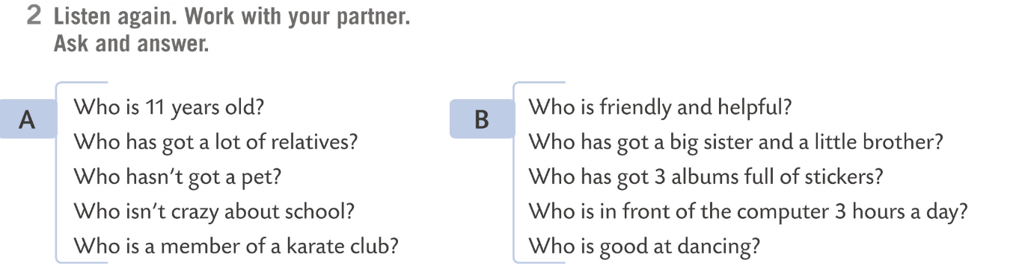
Task 2
https://www.e-sfera.hr/dodatni-digitalni-sadrzaji/c75e3b2c-b8bd-4084-a6be-3160e99b2651/assets/audio/03_lesson_1_cathy_and_mike.mp3
M
C
M
M
M
C
M
M
C
C

Slide 7
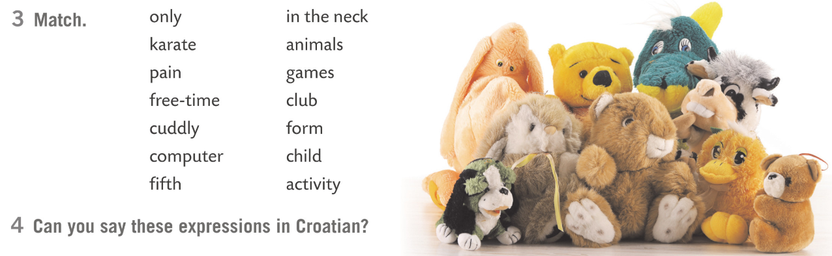
1
3
2
5
3
6
4
2
5
7
6
1
7
4
1 jedino dijete / jedinac
Play the game:
https://wordwall.net/resource/274159/engleski-jezik/cathy-mike-vocabulary
2 karate klub
3 dosadnjaković
4 aktivnosti u slobodno vrijeme
5 plišane životinje
6 računalna igrica
7 peti razred

Slide 8
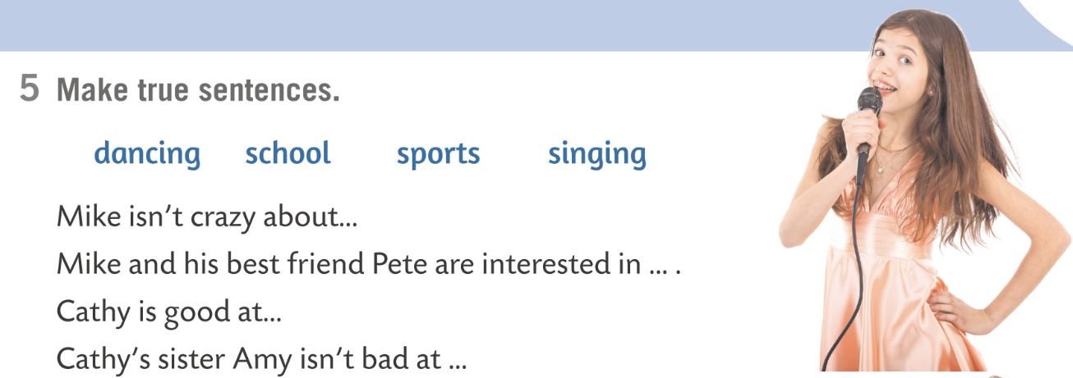
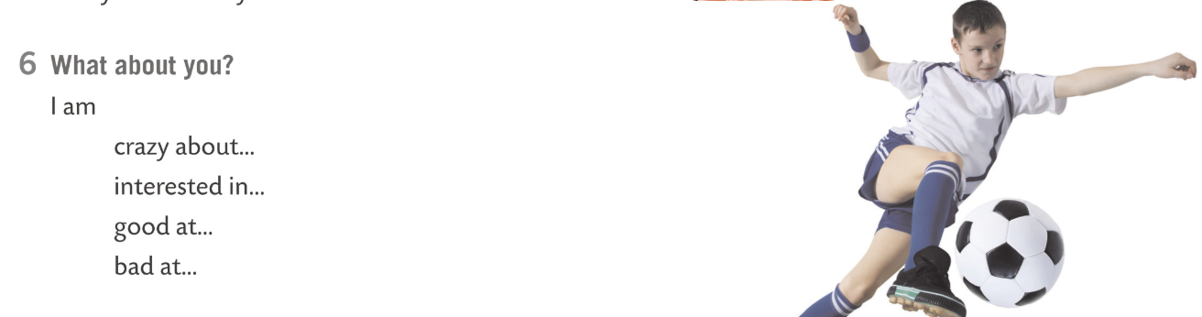




school.
sports.
dancing.
singing.
= lud za
= zainteresiran za
= dobar u
= loš u

Slide 9
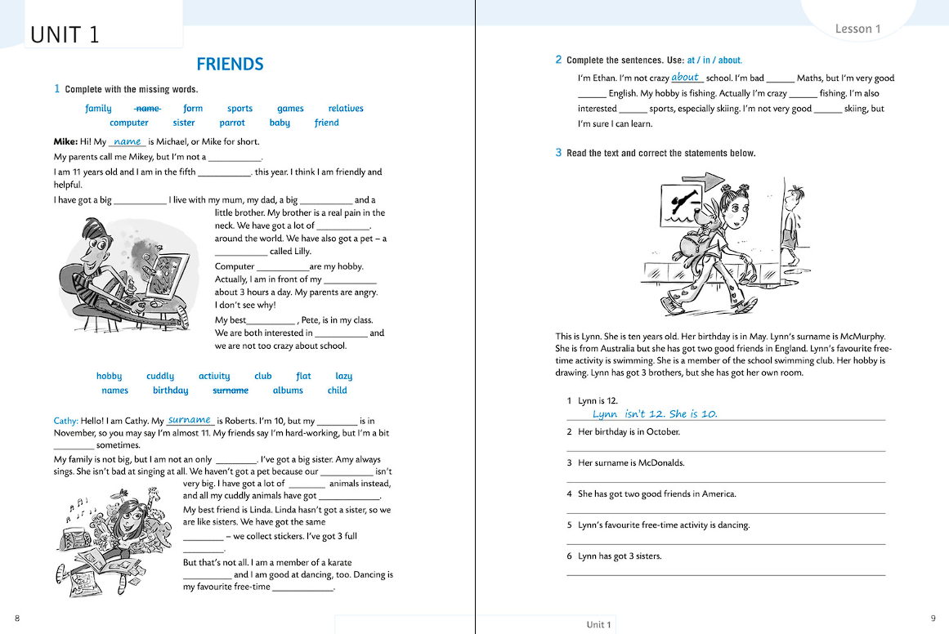
Dosad naučeno uvježbaj rješavajući zadatak na sljedećoj poveznici:
https://www.e-sfera.hr/dodatni-digitalni-sadrzaji/c75e3b2c-b8bd-4084-a6be-3160e99b2651/

Slide 10
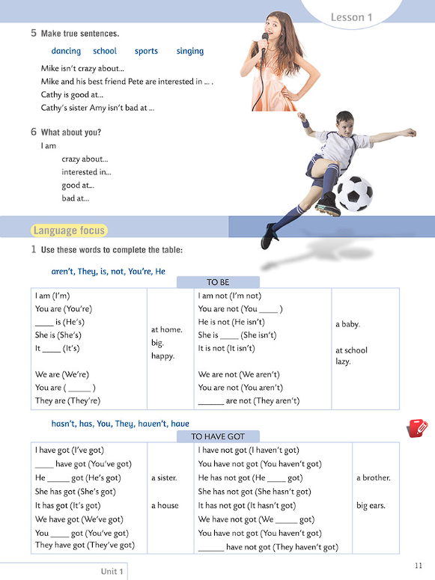
CHECK LANGUAGE FOCUS on p.11
Here you can see how to use TO BE (biti) i HAVE GOT (imati).

Slide 11
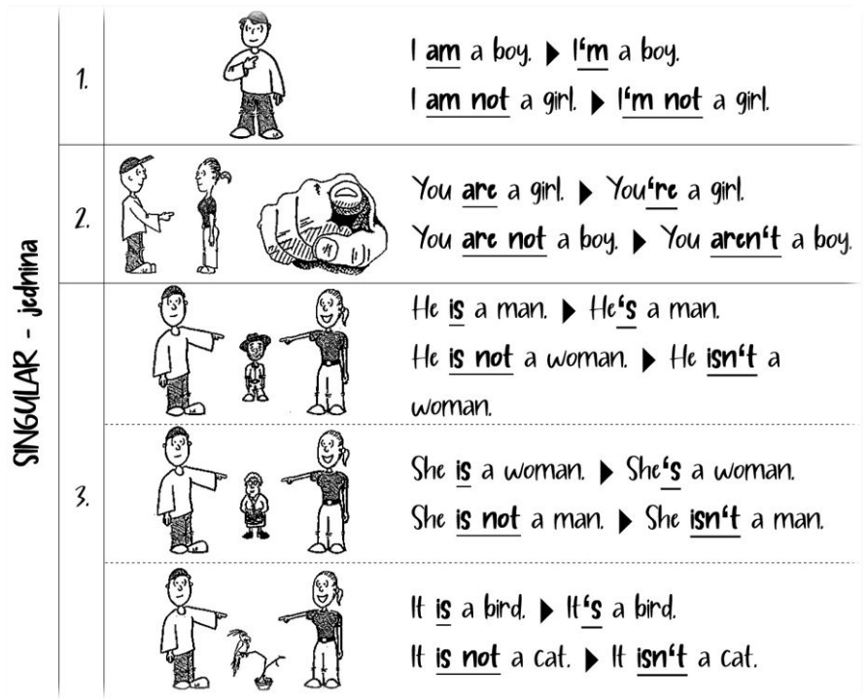
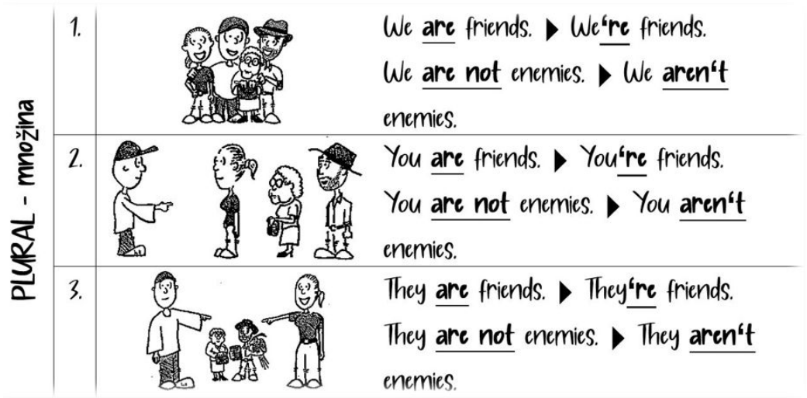
GLAGOL BITI – TO BE
kada govoriš o sebi (1. lice jednine) koristit ćeš AM (‘m), tj. u negativnom obliku AM NOT (‘m not)
kada se obraćaš nekom drugom (2. lice jednine) i u množini koristit ćeš ARE (‘re), tj. u negativnom obliku ARE NOT (aren’t)
kada govoriš o nekom trećem (3. lice jednine) koristit ćeš IS (‘s), tj. u negativnom obliku IS NOT (isn’t)

Slide 12
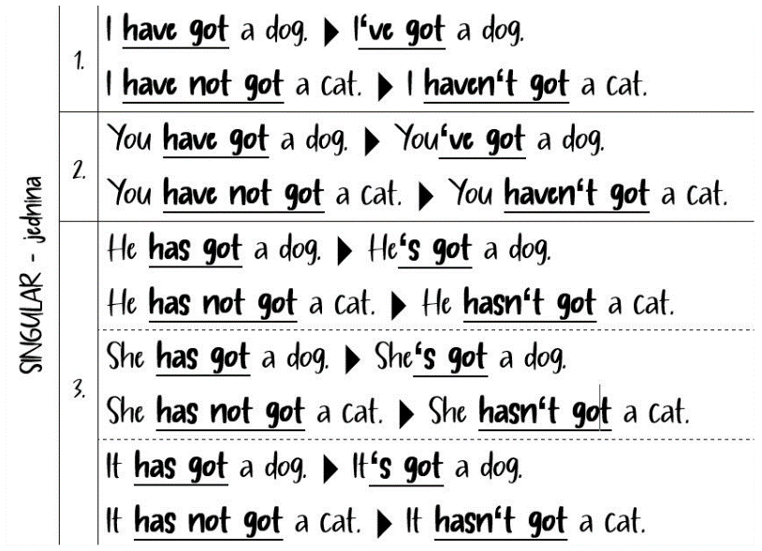
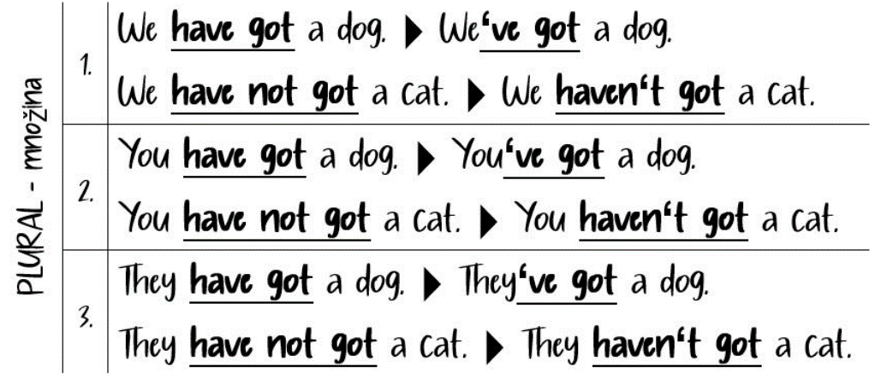
GLAGOL HAVE – IMATI
kada govoriš o sebi (1. lice jednine), kada se obraćaš nekom drugom (2. lice jednine) i u množini koristit ćeš HAVE (‘ve), tj. u negativnom obliku HAVE NOT (haven’t)
kada govoriš o nekom trećem (3. lice jednine) koristit ćeš HAS (‘s), tj. u negativnom obliku HAS NOT (hasn’t)

Slide 13
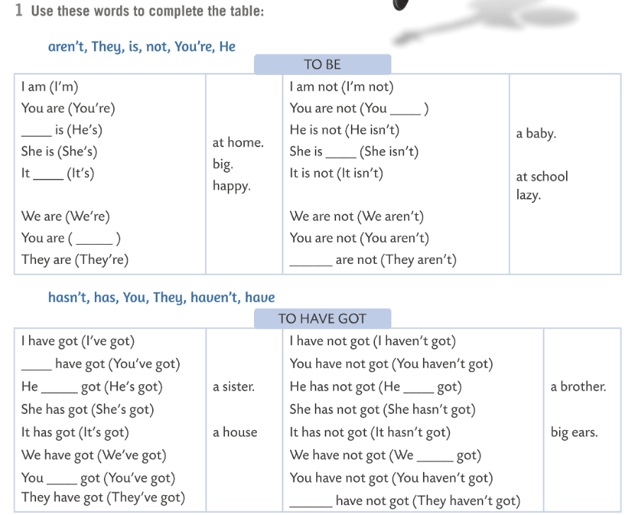
Practise the verbs BE and HAVE here.
aren’t
He
not
is
There are more exercises to practice the verb to BE:
https://wordwall.net/resource/274170/engleski-jezik/
https://wordwall.net/resource/271079/present-simple
https://create.kahoot.it/share/87aec4f2-8cda-4cf2-9e7f-33636911b18b
You’re
They
You
has
hasn’t
haven’t
have
They

Slide 14
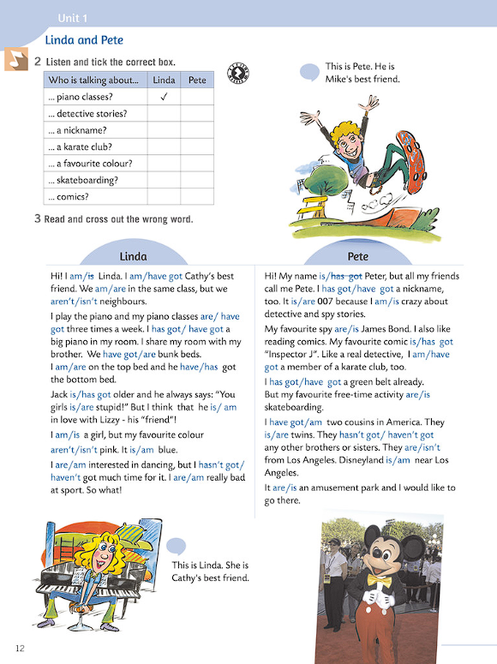
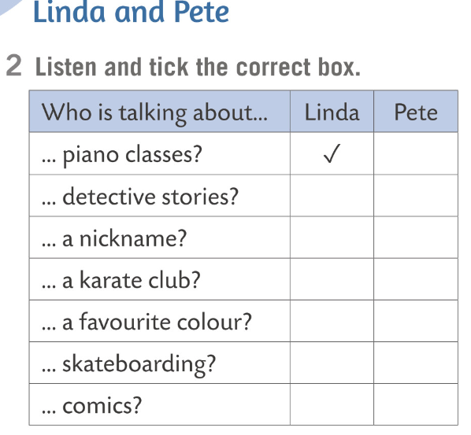


Slide 15
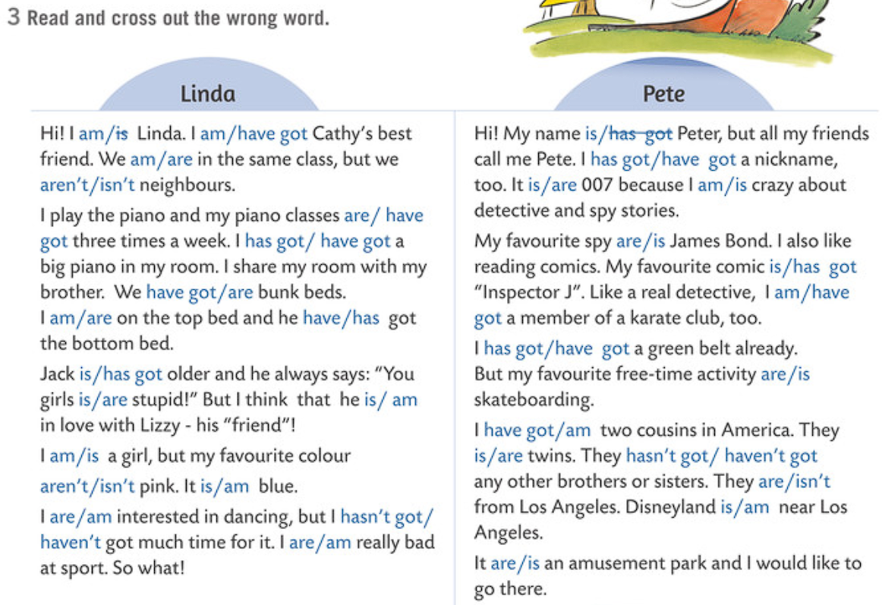

share dijeliti
bunk bed krevet na kat
top bed gornji krevet
bottom bed donji krevet
nickname nadimak
comics stripovi
belt pojas
amusement park zabavni park

Slide 16
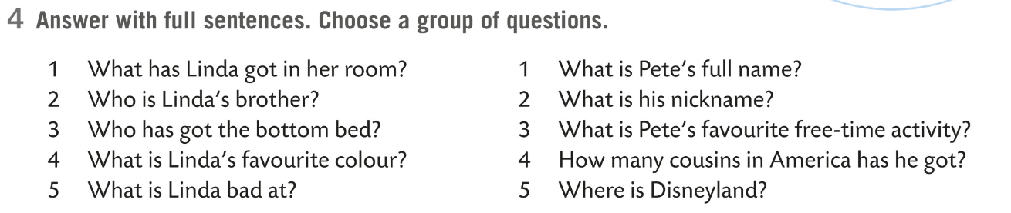
1 She has got a big piano ih her room.
2 Jack is Linda’s brother.
3 Jack has got the bottom bed.
4 Linda’s favourite colour is blue.
5 Linda is bad at sport.
1 Pete’s full name is Peter.
2 His nickname is 007.
3 Pete’s favourite free time activity is skateboarding.
4 He has got two cousins in America.
5 Disneyland is near Los Angeles.

Slide 17
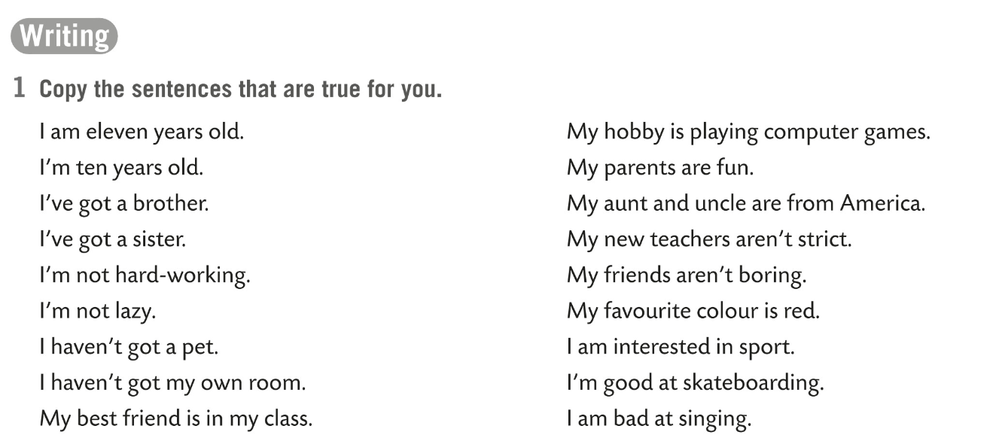

Slide 18
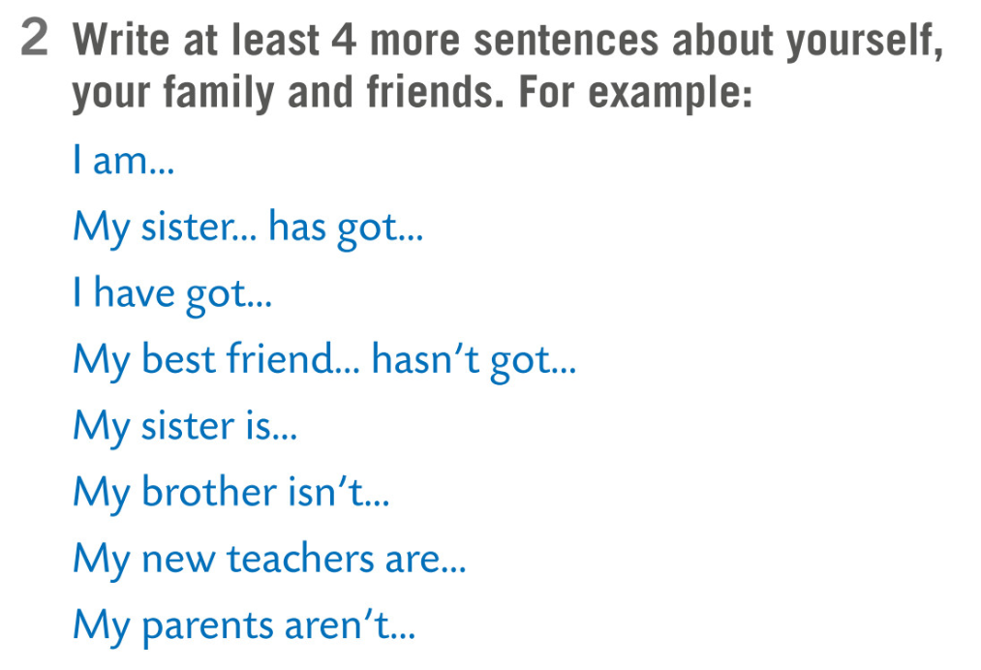

Slide 19
